Slide 1
NEW RIGHTS OF PERSONS WITH DISABILITIES ACT 2016
Office of the State Commissioner for Persons with Disabilities
and
Disability NGOs Alliance (DNA)

Slide 2
Principles for Empowerment of PWDs Chapter 1
Respect for inherent dignity, individual autonomy including the freedom to make one’s own choices, and independence of persons
Non- discrimination
Full and effective participation and Inclusion in society
Respect for difference and acceptance of PWDs as part of human diversity and humanity
Equality of opportunity
Accessibility
Equality between men and women
Respect for the evolving capacities of CWDs and respect for the right of CWDs to preserve their identities

Slide 3
Salient Features Chapter 1
The Lok Sabha & Rajya Sabha passed "The Rights of Persons with Disabilities Bill - 2016" on 14.12.2016.. The Bill will replace the existing PwD Act, 1995, which was enacted 21 years back.
Disability has been defined based on an evolving and dynamic concept.
The types of disabilities have been increased from existing 7 to 21 and the Central Government will have the power to add more types of disabilities.
Responsibility has been cast upon the appropriate governments to take effective measures to ensure that the PWDs enjoy their rights equally with others.
Additional benefits such as reservation in higher education, government jobs, reservation in allocation of land, poverty alleviation schemes etc. have been provided for PWDs with benchmark disabilities and those with high support needs.

Slide 4
Salient Features contin…
For strengthening the Prime Minister's Accessible India Campaign, stress has been given to ensure accessibility in public buildings (both Government and private) in a prescribed time-frame.
Reservation in vacancies in government establishments has been increased from 3% to 4% for certain persons or class of persons with benchmark disability.
The Bill provides for grant of guardianship by District Court under which there will be joint decision – making between the guardian and the persons with disabilities.
The Chief Commissioner for Persons with Disabilities and the State Commissioners will act as regulatory bodies and Grievance Redressal agencies and also monitor implementation of the Act.

Slide 5
7. Intellectual Disability
1. Blindness
2. Low-vision
10. Cerebral Palsy
3. Leprosy Cured
5. Locomotor Disability
12. Chronic Neurological conditions
6. Dwarfism
8. Mental Illness
13. Specific Learning Disabilities
21 Dis
Abili ties
11. Muscular Dystrophy
14. Multiple Sclerosis
15. Speech & Language disability
4. Hearing Impairment (deaf and hard of hearing)
16. Thalassemia
17. Hemophilia
18. Sickle Cell disease
20. Acid Attack victim
19. Multiple Disabilities including deaf-blindness
21. Parkinson's disease
9. Autism Spectrum Disorder

Slide 6
Key Disability Classification
PHYSICAL DISABILITY
A. Locomotor disability
1) Leprosy cured person 2) Cerebral Palsy
3) Dwarfism 4) Muscular Dystrophy
5) Acid attack victims
B. Visual Impairment
1) Blindness 2) Low- vision 3) Hearing Impairment 4) Speech & Language Disability
INTELLECTUAL DISABILITY
1) Specific Learning Disability
2) Autism Spectrum Disorder
3) Mental Illness (subnormality of intelligence)
DISABILITY CAUSED DUE TO
A. Chronic Neurological conditions such as:
1) Multiple Sclerosis
2) Parkinson’s Disease
B. Blood disorder such as:
1) Hemophilia 2) Thalassemia
3) Sickle Cell Disease
MULITPLE DISABILITIES
More than one of the mentioned specified disabilities

Slide 7
IMPORTANT DEFINITIONS PRELIMINARY

Slide 8
Important Definitions
BARRIER means any factor including communicational, cultural, economic, environmental, institutional, political, social, attitudinal or structural factors which hampers the full & effective participation of PWDs in society
CAREGIVER – any persons including parents & other family members who with or without payment provides care, support or assistance to a PWD
DISCRIMINATION – any distinction, exclusion, restriction on the basis of disability
HIGH SUPPORT - an intensive support, physical, psychological and otherwise for daily activities
INCLUSIVE EDUCATION - a system of education wherein students with and without disability learn together and the system of teaching and learning is suitably adapted to meet the learning needs of different types of students with disabilities
PERSON WITH BENCHMARK DISABILITY - a person with not less than 40% of a specified disability by the certifying authority

Slide 9
Important Definitions contin….
PERSON WITH DISABILITY - a person with long term physical, mental, intellectual or sensory impairment which, in interaction with barriers, hinders his full & effective participation in society equally with others
PUBLIC BUILDING - a Govt. or private building, used or accessed by the public at large, including used for educational or vocational purposes, workplace, commercial activities, public utilities, religious, cultural, leisure or recreational activities, medical or health services, law enforcement agencies, judicial foras, railway stations or platforms, roadways, bus stands or terminus, airports or waterways
REASONABLE ACCOMMODATION - necessary and appropriate modification and adjustments, without imposing a disproportionate or undue burden in a particular case, to ensure to PWDs the enjoyment or exercise of rights equally with others
REHABILITATION - refers to a process aimed at enabling PWDs to attain and maintain optimal, physical, sensory, intellectual, psychological environment or social function levels

Slide 10
EARLY iNTERVENTiON AND HEALTH

Slide 11
We see how early childhood experiences are so important to lifelong outcomes, how the early environment literally becomes embedded in the brain and changes its architecture”
Andrew s Garner

Slide 12
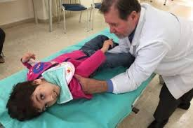
Rehabilitation and Health
Chapter 5
The appropriate Govt. shall formulate necessary schemes and programs to safeguard and promote the right of PWDs for adequate standard of living to enable them to live independently or in the community.
Community centers with good living conditions in terms of safety, sanitation, health care and counseling
Access to safe drinking water and appropriate and accessible sanitation facilities especially in urban slums and rural areas
Provisions of aids and appliances, medicine and diagnostic services and corrective surgery free of cost to PWDs with such income ceiling as notified
Undertake surveys, investigations and research concerning the cause of occurrence of disabilities

Slide 13
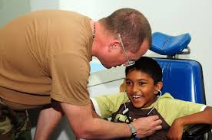
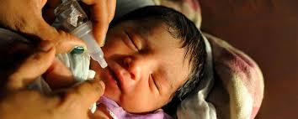
Rehabilitation and Health
5. Promote various methods of preventing disabilities
6. Screen all the children at least once in a year for the purpose of identifying “ at –risk” cases
7. Provide facilities for training to the staff at the Primary Health Centers (PHCs)
8. Sponsor to awareness campaigns and disseminate information for general hygiene, health and sanitation
9. Take measures for pre-natal, perinatal and post-natal care of mother and child
10. Educate the public and create awareness amongst the masses through Televisions, Radio and other mass media on the cause of disabilities and the preventive measures to be adopted

Slide 14
Rehabilitation and Health contin…
11. Sexual and reproductive healthcare especially for women with disability
12. The appropriate Govt. and the local authorities, while formulating Rehabilitation Policies shall consult the NGOs working for the cause of PWDs
13. The appropriate Govt. shall designate persons, having requisite qualifications and experience, as certifying authorities, who shall be competent to issue the certificate of disability
14. Initiate research and development through individuals and institutions on issues which shall enhance habilitation and rehabilitation and on such other issues which are necessary for the empowerment of PWDs

Slide 15
iNCLUSIVE EDUCATION

Slide 16
INCLUSIVE EDUCATION means
….all children will be educated full-time in age-appropriate general education classrooms in their neighborhood schools with support provided to enable students, teachers and the entire school community to succeed”
-UNH Institute on Disability

Slide 17
Inclusive Education
Chapter 3
The appropriate Govt. and the local authorities or recognized educational institutions by them provide inclusive education to the CWDs
Admit CWDs without discrimination and provide education and opportunities for sports and recreation activities equally with others
Ensure that the education to persons who are blind or deaf or both is imparted in the most appropriate languages and modes and means of communication
Detect specific learning disabilities in children at the earliest and take suitable pedagogical and other measurers to overcome them
Respect for inherent dignity, individual autonomy including the freedom to make one’s own choices, and independence of persons

Slide 18
Inclusive Education contin…
5. Monitor participation, progress in terms of attainment levels and completion of education in respect of every student with disability
Provide transportation facilities to the CWDs and also the attendant of the CWDs having high support needs
To conduct survey of school going children in every five years for identifying CWDs, ascertaining their special needs and the extent to which these are being met; the first survey shall be conducted within a period of two years from the date of commencement of this Act (Section 16)
To train and employ teachers, including teachers with disability who are qualified in Indian Sign Language (ISL) and Braille and also teachers who are trained in teaching children with Intellectual Disability
To train professionals and staff to support Inclusive Education at all levels of school education

Slide 19
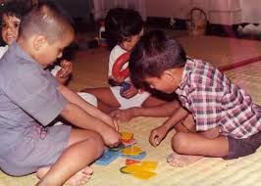
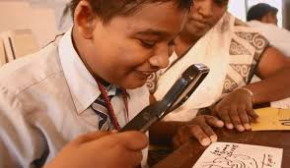
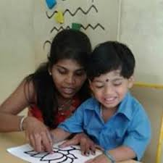
Inclusive Education contin…
10. Promote the use of appropriate augmentative and alternative modes including means and formats of communication, Braille and ISL to supplement the use of one’s own speech to fulfill the daily communication needs of persons with speech, communication or language disabilities and enables them to participate and contribute to their community and society
11. To provide books, other learning materials and appropriate assistive devices to students with benchmark disabilities free of cost up the age of 18 years
12. Make building, campus and various facilities accessible
13. Provide reasonable accommodation according to the individual’s requirements
14. Provide necessary support individualized or otherwise in environments that maximize academic and social development consistent with the goal of full inclusion

Slide 20
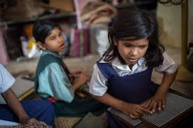
Inclusive Education contin…
15. To establish adequate number of Teacher Training Institutions and establish adequate number of resource centers to support educational institutions at all levels of school education
16. To make suitable modifications in the curriculum and examination system to meet the needs of students with disabilities such as extra time for completion of examination paper, facility of scribe or amanuensis, exemption from second and third language courses
17. To promote research to improve learning and any other measures required

Slide 21
LiVELiHOOD

Slide 22
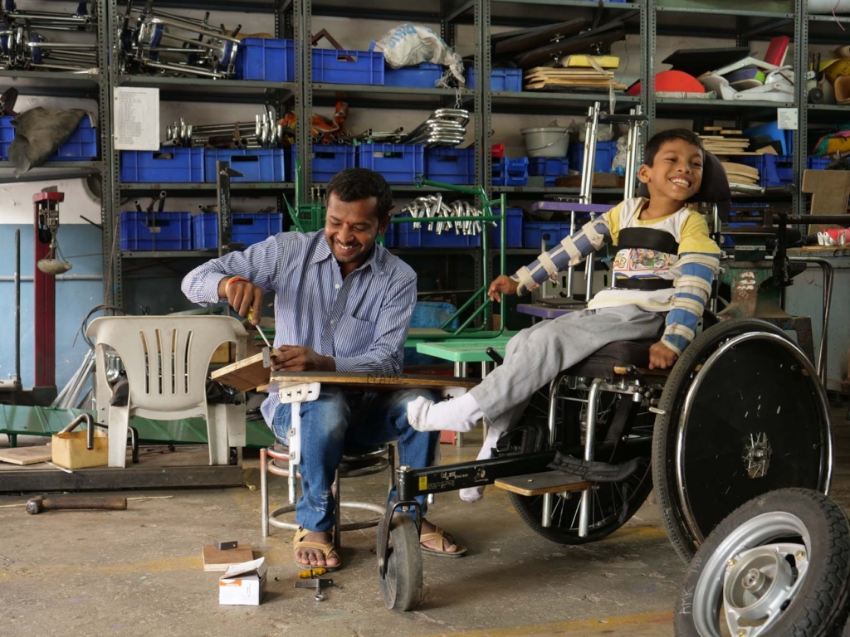
It is more important to find out what you are giving society than to ask what is the right means of livelihood”
Jiddu Krishnamurthy

Slide 23
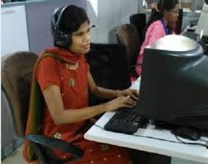
Skill Development and Employment
Chapter 4
The appropriate Govt. shall formulate schemes and programs including provisions of loans at concessional rates to facilitate and support employment of PWDs especially for their vocational training and self-employment
Inclusion of PWDs in all mainstream formal and non – formal vocational and skill training schemes and programs
Exclusive skill training programs for PWDs with active links with the market, for those with developmental, intellectual, multiple disabilities and autism
Loans and concessional rates including that of microcredit and Marketing the products made by PWDs

Slide 24
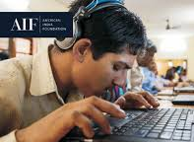
Skill Development and Employment
Maintenance of disaggregated data on the progress made in the skills training and self-employment and employment
No promotion shall be denied to a persons merely on the ground of disability
If an employee after acquiring disability is not suitable for the post he / she was holding, shall be shifted to some other post with the same pay scale and service benefits

Slide 25
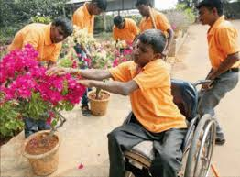
Skill Development and Employment ..cont..
7. Every Govt. establishment shall provide reasonable accommodation and appropriate barrier free and conducive environment to employees with disability
8. The appropriate Govt. may frame policies for posting and transfer of employees with disabilities
9. Every establishment shall maintain records of the PWDs in relation to the matter of employment, facilities provided and other necessary information in compliance with the provisions
10. Every Govt. establishment shall appoint a Grievance Redressal Officer (section 19) to address any complaints with corrective action with proper register of complaints and action taken

Slide 26
AFFIRMATIVE ACTIONS FOR ACCESSIBILITY & BUILD ECO-SYSTEM

Slide 27
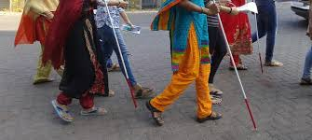
Accessibility without inclusion does not necessarily create the attitude or sense of value we need to feel like we belong in a group or in our community”

Slide 28
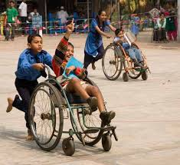
Accessibility and Eco-system
Chapter 2, 3,456,7,8 &10
The State Fund for PWDs shall maintain proper accounts and other relevant records including the income & expenditure
INCLUSIVE EDUCATION:
Make school building, campus and various facilities accessible including toilet, classrooms, playground
To establish adequate number of Teacher Training Institutions and establish adequate number of resource centers to support educational institutions at all levels of school education
To make suitable modifications in the curriculum and examination system to meet the needs of students with disabilities

Slide 29
Accessibility and Eco-system
INCLUSIVE EDUCATION:
To promote research to improve learning and any other measures required
Restructure courses, programs, redesign and support infrastructure facilities to ensure access, inclusion and participation of PWDs in all sporting activities
All Govt. institutions of higher education and other higher education institutions receiving aid from the Govt. shall reserve not less than 5% seats for persons with benchmark disabilities
The persons with benchmark disabilities shall be given an upper age relaxation of 5 years for admission in institutions of higher education

Slide 30
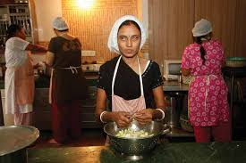
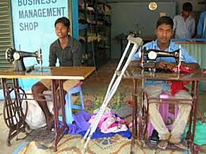
Accessibility and Eco-system cont….
SKILL DEVELOPMENT & EMPLOYMENT:
The appropriate Govt. may frame policies for posting and transfer of employees with disabilities
Every Govt. establishment shall appoint a Grievance Redressal Officer (section 19) to address any complaints with corrective action with proper register of complaints and action taken
Unemployment allowance to PWDs registered with special Employment Exchange for more than 2 years and who could not be placed in any gainful occupation
Constitute an expert committee with representation of persons with benchmark disabilities for identification of posts

Slide 31
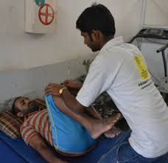
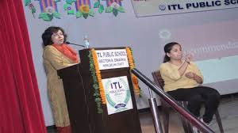
Accessibility and Eco-system cont….
SKILL DEVELOPMENT & EMPLOYMENT:
Identify posts in the establishments by respective category of persons with benchmark disabilities in respect of the vacancies reserved as per section 34.
Every Govt. establishment shall appoint, not less than 4% of the total number of vacancies in the cadre strength in each group of posts ( 1%- blindness, low vision, deaf & hard of hearing, 1% - loco, CP, leprosy cured, dwarfism, acid attack victims & muscular dystrophy, 1% - autism, ID, SLD, MI & 1% - Multiple disabilities)
The appropriate Govt. & local authorities shall, within the limit of their economic capacity and development, provide incentives to employer in private sector to ensure that at least 5% of their work force is composed of persons with benchmark disability

Slide 32
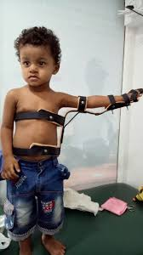
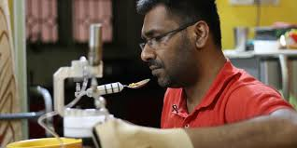
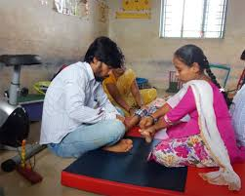
Accessibility and Eco-system cont…
REHABILITATION AND HEALTH:
Barrier –free access in all parts of Govt. and Private hospitals and other healthcare institutions and centers
Conduct Surveys, investigations and research concerning the cause of occurrence of disabilities
Create awareness on Disability, rehabilitation, management and prevention

Slide 33
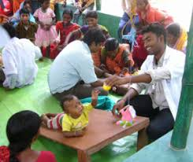
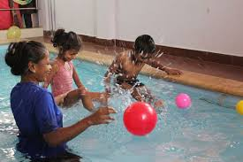
Accessibility and Eco-system cont…
REHABILITATION AND HEALTH:
Screen all the children from Primary Health Centers to Maternity Hospitals and Multi-Specialty Hospitals to identify ‘at –risk’ cases; rural, semi-urban and urban areas
The Govt. appropriate Govt. and the local authorities should formulate rehabilitation policies
Promoting recreation centers like Theatres, Cinema Halls etc and other associational activities
Developing technology, assistive devices and equipments to facilitate access and inclusion for PWDs

Slide 34
Accessibility and Eco-system cont…
SOCIAL SECURITY SCHEMES AND DEVELOPMENT PROGRAM:
5% reservation in allotment of agricultural land and housing in all relevant schemes and development programs, with appropriate priority to women with benchmark disabilities
5% reservation in all poverty and alleviation and various development schemes with priority to women with benchmark disabilities
5% reservation in allotment of land on concessional rate for the purpose of promoting housing, shelter, setting up of occupation, business, enterprise, recreation centers and production centers

Slide 35
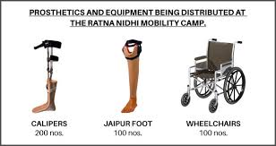
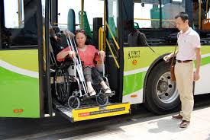
Accessibility and Eco-system cont…
SOCIAL SECURITY SCHEMES AND DEVELOPMENT PROGRAM:
The programs and campaigns to promote values of inclusion, tolerance, empathy, respect for diversity, recognition of the skills, merits and abilities of PWDs
Developing technology, assistive devices and equipments to facilitate access and inclusion for PWDs
Ensure that the rights of PWDs are included in the curriculum in Universities, colleges and schools
Access to all modes of transport that confirm the design standards and including retrofitting old modes of transport and personal mobility assistance
Mandate training on disability rights in all courses for the training of PRI members, legislators, administrators, police officials, judges and lawyers

Slide 38
Advisory Boards and Committee
Chapter 11
The Advisory Board consists of:
Minister in charge of Department of Central / State Govt. dealing with Disability matters as a Chairperson, ex officio
3 members of MP/ MLA
Secretaries in charge of the Depts of Disability Affairs and other related Depts
Director, Directorate of Differently Able & Senior Citizens
Joint Secretary in the Dept dealing with disability matters
Directors of 9 National Institutes
Central and State Advisory Boards
Nominated Members-Total 18
Three representatives of national / state level Chambers of Commerce and Industry
Five Experts from the field of disability and rehabilitation
Ten members preferably PWDs as representatives of NGOs working on the issue of disability ( out of these, 5 should be women, 1 SC and 1 ST)
Shall meet at least once in six months. Advise, develop a national policy, review, coordinate, recommend steps, monitor & evaluate

Slide 39
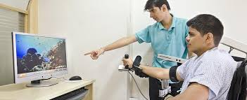
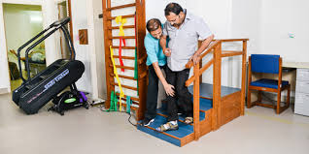
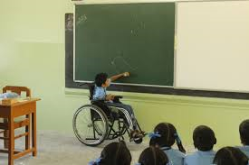
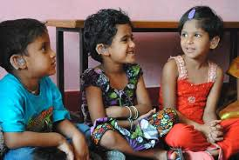
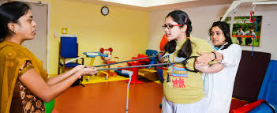

Slide 40
THANKS!
Any questions?
You can find at
scdkarnataka@gmail.com 080-4152 5671
contact@dna-india.org +918884068090

Slide 41
Advisory Boards and Committee
The Central Advisory Board shall consists of:
Minister in charge of Department of Disability Affairs as a Chairperson, ex officio
Minister of State in charge dealing with Dept. of Disability Affairs
3 members of parliament
The Minister in charge of Disability Affairs of all States & Administrators
Secretaries to the Govt. of India in charge of Ministries or Dept of Disability Affairs
Secretary , National Institute of Transformation India (NITI) Ayoga,
Chairperson, Rehabilitation Council of India (RCI)
Chairperson, National Trust for the Welfare of Persons with Autism, CP, MR and Multiple Disabilities
Chairman cum Managing Director, National Handicapped
Finance Development Corporation
Chairman, Railway Board
Director – General, Employment & Training, Ministry of Labor & Employment
Director, National Council for Education Research and Training
Chairperson, University Grants Commission
Chairperson, Medical Council of India
Directors of 9 National Institutes
Nominated Members by the Central Govt: 5 members from Disability & Rehab field, 10 PWDs & upto 3 representatives of national level chambers of commerce & industry
Joint Secretary to the Govt of India – disability policy
Shall meet at least once in six months. Advise, develop a national policy, review, coordinate, recommend steps, monitor & evaluate

Slide 42
Advisory Boards and Committee cont…
The State Advisory Board shall consists of:
Minister in charge of Department of State Govt. dealing with Disability matters as a Chairperson, ex officio
Minister of State or the Deputy Minister in charge of the Dept in dealing with Dept. of Disability matters as Vice Chairperson
3 members of State Legislature
Secretaries in charge of the Depts of Disability Affairs, School Education, Literacy & Higher Education, Women & Child, Finance, Personnel & Training, Health & Family Welfare, RDPR, Industrial Policy & Promotion, Labour & Employment, Urban Development, Housing & Urban Poverty Alleviations, Science & Technology, Information Technology, Public Enterprises, Youth Affaires & Sports, Road Transportation and any other Dept.
Director, Directorate of Differently Alble & Senior Citizens
Nominated Members by the State Govt: 5 members from Disability & Rehab field, 5 members from districts by rotation to represent, 10 PWDs & upto 3 representatives of state chambers of commerce & industry
Joint Secretary in the Dept dealing with disability matters
Shall meet at least once in six months. Advise, develop a national policy, review, coordinate, recommend steps, monitor & evaluate

